Slide 1
BSCS 3-3
Simple Arithmetic Quiz Application
Assemby Project

Slide 2
Description!
This project is a simple quiz application made with NASM.
It has a console interface.
This project is for the fulfillment of the course subject,
Computer Organization and Assembly Language.

Slide 3
Project Scope
The scope of this project extends to a simple quiz application. It will only feature simple arithmetic problems.
The purpose of this project is to test the knowledge of young students about basic math.
The expected users of this application are Grade 3 students.

Slide 4
OBJECTIVES
Technical
Schedule
To fully build and design a working project using an assembly language, NASM.
To complete this small-scale project within 1 week

Slide 5
DELIVERABLES
System
Documentation
Simple Arithmetic Quiz Application
Documentation of the assembly program

Slide 6
PROJECT TEAM
Mark Edison Rosario
Bismillah Constantino
Project Manager
Developer
Piolo Brian Jizmundo
Jeremy Cube
Jericho Vince Tacata
Developer
Developer
Developer

Slide 7
Implementation
Tasks
Procedure
Technology
Console Read/Write
Data Handling
Arithmetic Expressions Conditional Statements Macros
NASM

Slide 8
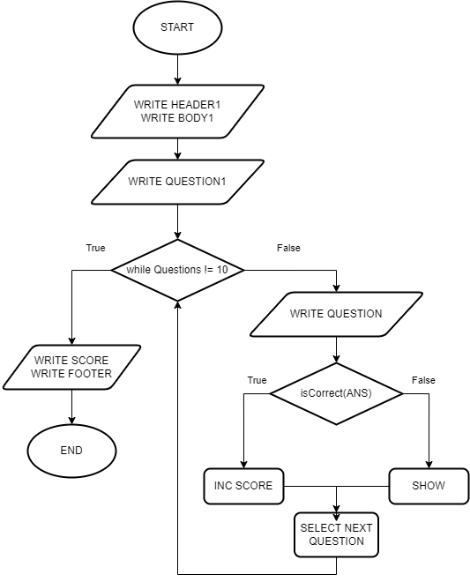
Application Flow

Slide 9
PROJECT SCHEDULE
01
02
03
04
Identification
Design
Development
Presentation
February 11, 2022
February 14, 2022
February 15, 2022
-
February 21, 2022
March 1, 2022

Slide 10
System
Simple Arithmetic Quiz Application

Slide 11
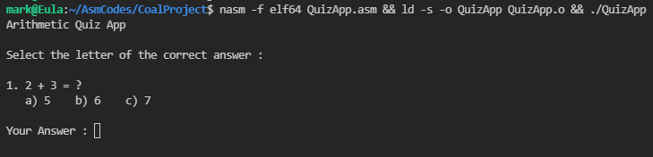
PROJECT
After the successful compilation of the assembly program. The program will then run and display the following messages.

Slide 12
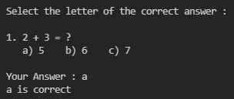
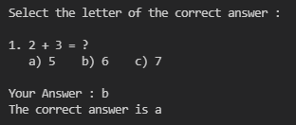
PROJECT
The program will ask the user’s answer. A message will be displayed depending on the correctness of the user’s answer.

Slide 13
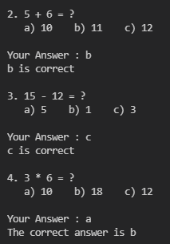
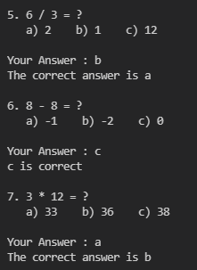
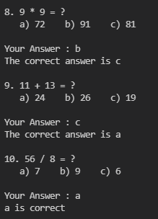
PROJECT
The program will continue to show the question and choices, and ask for the user’s answer. The program will end at the 10th question.

Slide 14

PROJECT
The program will display the accumulated score of the user. The program will end after displaying the following messages.

Slide 15
Live Demo & Source Code

Slide 16
Q & A

Slide 17
Thank You!

